Slide 1
Interviewing for Frontend Engineers

Slide 2

Jem Young
@jemyoung
Senior Software Engineer

Slide 3


Slide 4
Why is interviewing so difficult?
Notes:
How many hours do you spend studying for interviews?
How many hours do you spend training on how to give an interview?

Slide 5
Programming is math
3 types of programmers
Programming is for controlling hardware
Programming is for building things
https://josephg.com/blog/3-tribes/

Slide 6
Why is interviewing for Frontend so difficult?

Slide 7


Frontend
cars
televisions
browsers
desktop apps
appliances
mobile devices

Slide 8
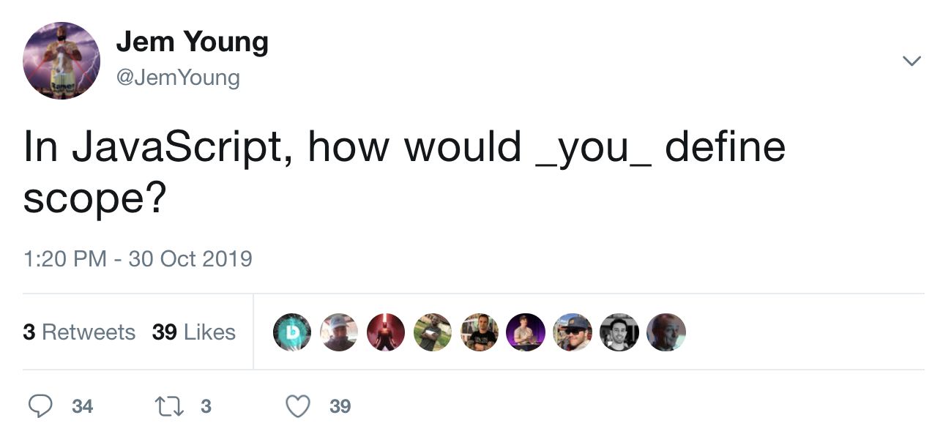

Slide 9
Interviewing for Frontend Engineers?
Notes:
Interviewing at FAANG companies is easier than startups because they have a process

Slide 10
candidate

Slide 11
interviewer

Slide 12
0.300
Notes:
Applied to best buy twice
applied to work at my local theme park IT department

Slide 13
0.501
Notes:
Can’t pass every interview but can increase your average
40 interviews - 2 onsites

Slide 14


Application
Initial call
Code test
Phone screen
On-site
Result
Notes:
Most people fail early on so this course covers all the steps
not just a bunch of exercises

Slide 15
Application

Slide 16
What do you like about your current job?

Slide 17
What sort of things are you looking for in your next role?

Slide 18
Which companies have appealing engineering cultures? What makes it appealing?

Slide 19
preparation
Application

Slide 20
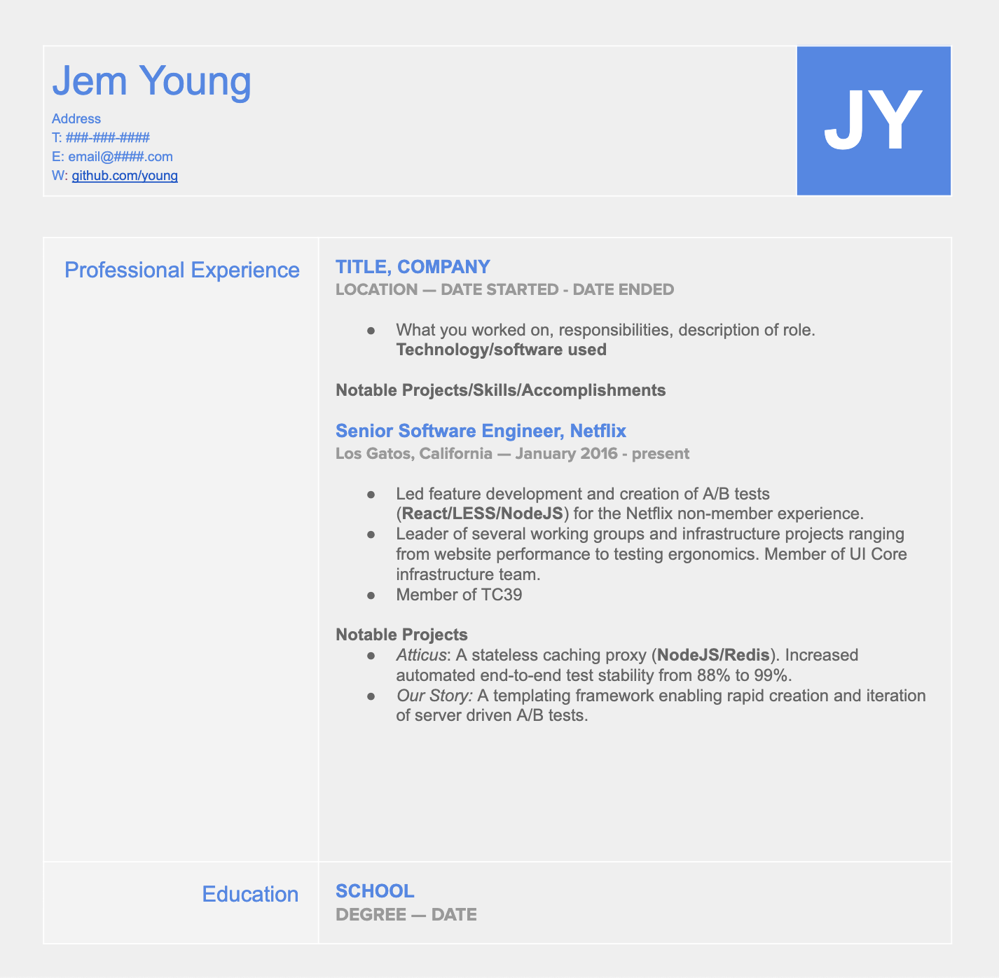
One page
Skills
Experience
Technology familiarity
Education
Accomplishments
Notes:
keep your resume up to date
GET A REFERRAL
Tailor your resume

Slide 21
What do I do if I have little/no experience?
Notes:
Some companies have roles for new grads
Have a robust github - A couple example
Give talks
Go to meetups
NETWORK

Slide 22
preparation
Application

Slide 23

Which roles does this person fit?
What sort of experience is required?
Is there any bias in your selection process?

Slide 24

Application
Initial call
Code test
Phone screen
On-site
Result

Slide 25
preparation
Initial call

Slide 26
What do you do currently?
What are some projects you’ve worked on recently?
What are you looking for in your next role?
Why do you want to work for ______?
What is your availability for the next steps?
Notes:
All these quesitons show interstest

Slide 27
preparation
Initial call

Slide 28
How many steps are in the interview process? How long does it generally take?
How big is your engineering team?
Which team would I be interviewing for?
What is the culture like?
Who are you competitors?
What sort of projects would I work on?
Notes:
Questions to prepare for

Slide 29
Prescreen
What is the difference between const, let, and var?
Explain prototypical inheritance
What is 'this' mean in JavaScript?
What is the data structure of the DOM?
What is a Stack and a Queue? How would you create those data structures in JavaScript?
How can you tell if an image element is loaded on a page?
What is call() and appy()?
What is event delegation and what are the performance tradeoffs?
What is a Worker? When would you use one?

Slide 30
What is the difference between const, let, and var?

Slide 31
Explain prototypical inheritance

Slide 32
What does ‘this’ mean in JavaScript?

Slide 33
What is the data structure of the DOM?

Slide 34
What is a Stack? What is a Queue? How would you create those data structures in JavaScript?

Slide 35
How can you tell if an image element is loaded on a page?

Slide 36
What are call() and apply()?

Slide 37
What is event delegation?

Slide 38
What is a Worker? When would you use one?

Slide 39
TRIVIA
Notes:
What does {} + [] do

Slide 40
Application
Initial call
Code test
Phone screen
On-site
Result

Slide 41
preparation
Code test

Slide 42
Make your code as readable as possible
Comment your code
Don’t over complicate the architecture
Don’t import too many libraries
If you have time, add unit tests
Ask questions!
Code test tips

Slide 43
preparation
Code test

Slide 44
Make the problem as straightforward as possible
Be honest with the time constraints
Have a code review checklist
Code test tips

Slide 45
Average | Good | Exceptional
Application starts properly. 3/5 requirements complete. | Code is well documented. All requirements are complete. No errors are thrown in the console. | Modular architecture designed for extensibility. Created unit and integration tests.

Slide 46
Knowledge: Big-O

Slide 47
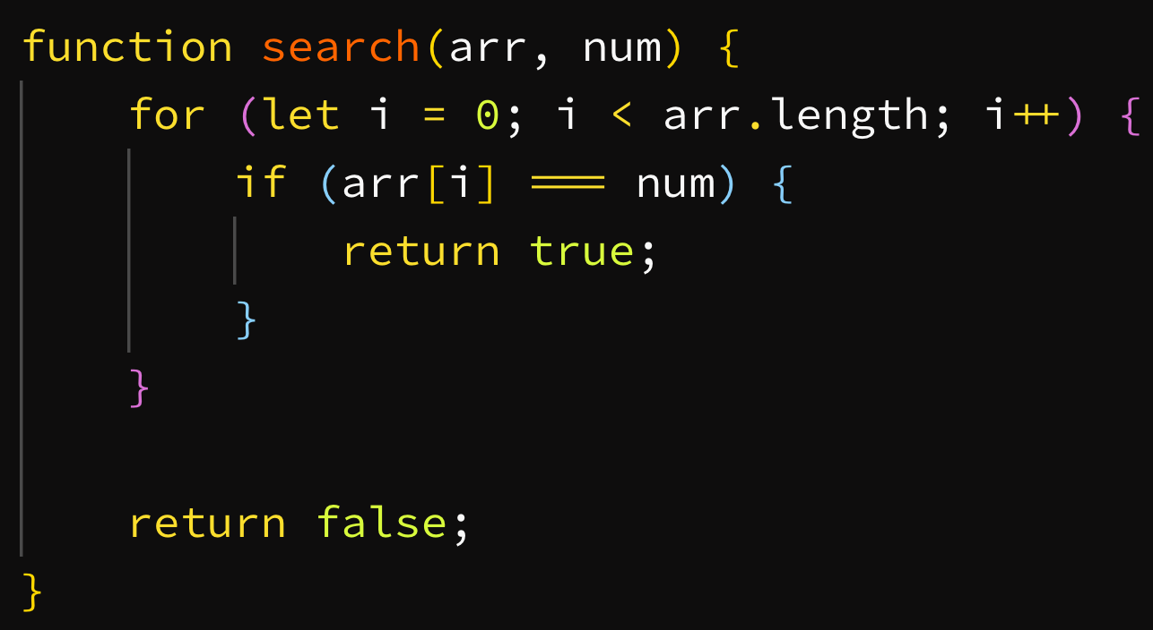

Slide 48
Ω
Θ
O
Big Omega
“best case”
“average case”
Big Theta
Big O
“worst case”

Slide 49
Ω(1)
Θ(n)
O(n)

Slide 50
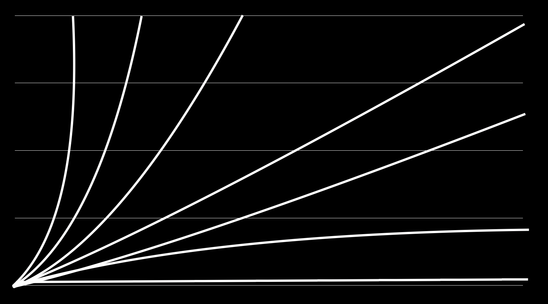
O(n!)
O(n²)
O(n log n)
O(2^{n})
O(n)
time (number of operations)
O(log n)
O(1)
number of elements

Slide 51
Ω(1)
Θ(n)
O(n)

Slide 52
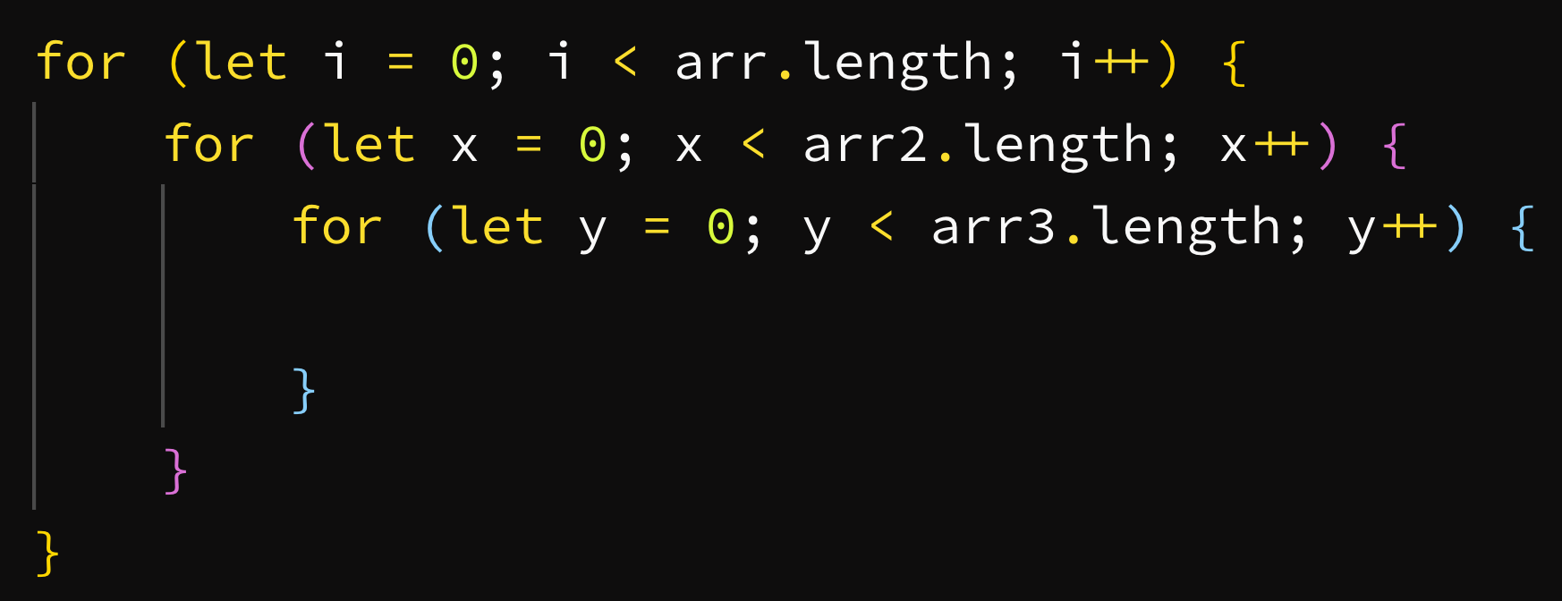

Slide 53
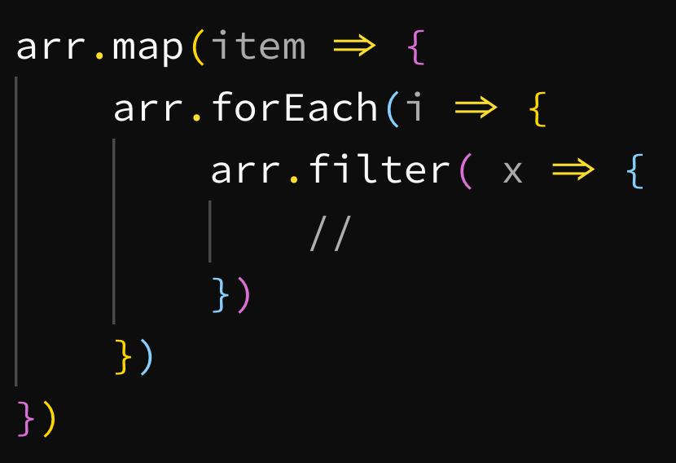

Slide 54
Application
Initial call
Code test
Phone screen
On-site
Result

Slide 55
preparation
Phone screen

Slide 56
Ask questions
Talk out your solution
Get comfortable with the environment

Slide 57
preparation
Phone screen

Slide 58
Are you in a quiet area?
Is the problem well worded?
Does the candidate know what the requirements and restrictions are?
Did you leave time for questions at the end?

Slide 59
Problem: phone screen

Slide 60
Application
Initial call
Code test
Phone screen
On-site
Result

Slide 61
preparation
On-site

Slide 62
Practice writing code without a computer
Go over general sample problems
Ask your friends to test you
Try to ask what the style of technical questions will be
Notes:
How to behave
How to assess company culture
What sort of questions to ask

Slide 63
preparation
On-site

Slide 64
Make sure questions are relevant to the role
Have backup interviewers
Book the room for the day
Allow time for breaks (bathroom, lunch, etc)

Slide 65
On-site

Slide 66
Knowledge: strings

Slide 67
.split()
.toLowerCase()
Useful methods
.substring()
.startsWith()

Slide 68
Problem: reverse

Slide 69
Knowledge: arrays

Slide 70
Object.entries()
Array.from()
[...item]

Slide 71
.isArray()
.pop()
.filter()
.push()
Useful methods
.reduce()
.map()
.concat()
.join()

Slide 72
Problem: duplicate strings
Notes:
Also known as find unique values

Slide 73
Problem: flatten array

Slide 74
Knowledge: scope

Slide 75
.call()
.apply()
.bind()

Slide 76
Problem: bind

Slide 77
Knowledge: timing

Slide 78
setInterval()
setTimeout()

Slide 79
Problem: debounce

Slide 80
Knowledge: trees

Slide 81
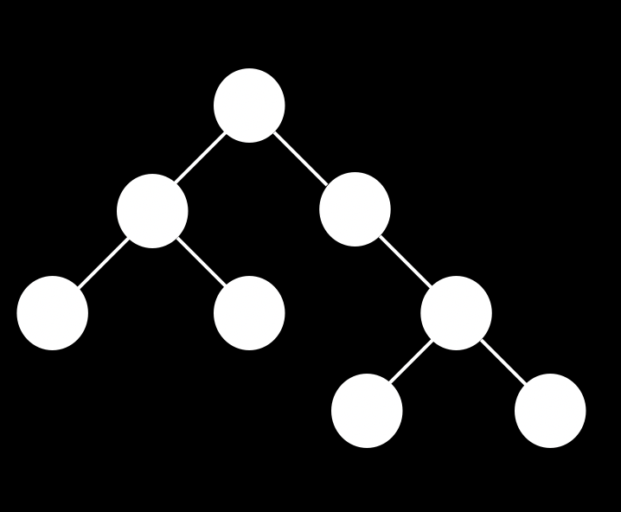
Root
Nodes

Slide 82
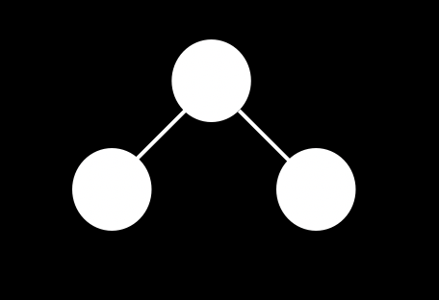
Children
Parent
[
0
1
]
,

Slide 83
A
B
?
Problem: domTree

Slide 84
Knowledge: rendering

Slide 85
requestAnimationFrame()

Slide 86
Problem: move element

Slide 87
Knowledge: promises

Slide 88
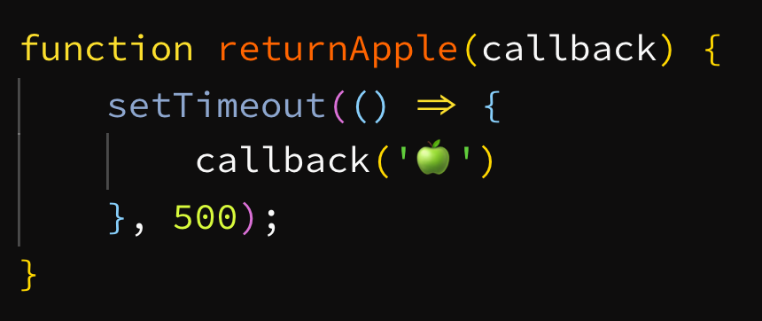
Notes:
“A Promise is a proxy for a value not necessarily known when the promise is created”

Slide 89
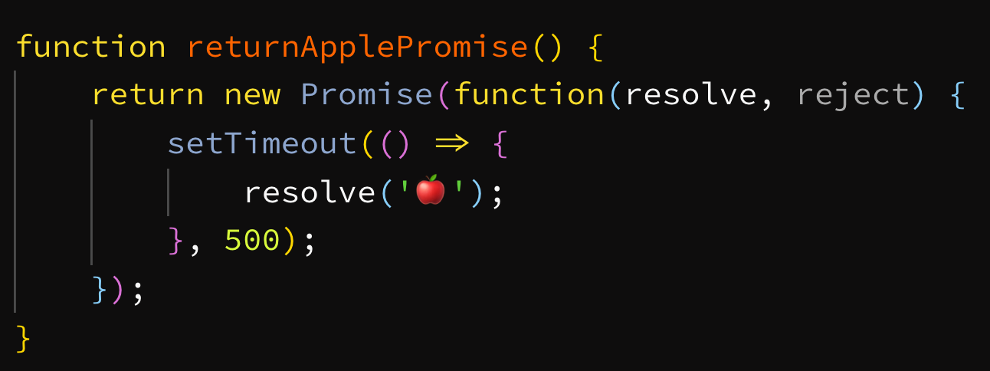

Slide 90
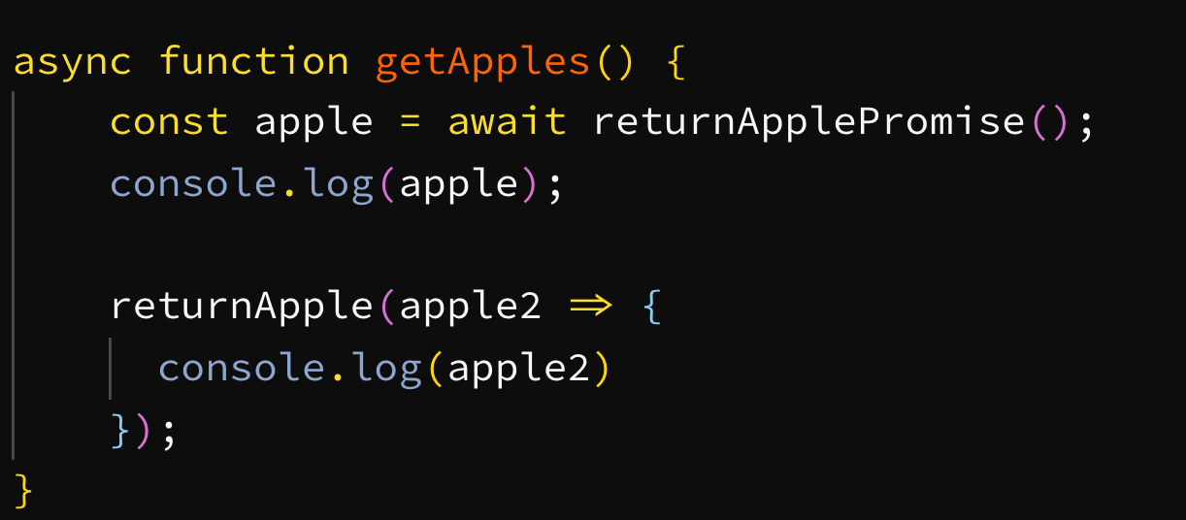
Notes:
“A Promise is a proxy for a value not necessarily known when the promise is created”

Slide 91
Problem: sleep

Slide 92
Problem: promisify

Slide 93
Application
Initial call
Code test
Phone screen
On-site
Result

Slide 94
preparation
Result

Slide 95
0.501

Slide 96
preparation
Result

Slide 97
Give feedback
Invite them to re-apply
Stay in touch

Slide 98
Thanks!

